Slide 1
INTERMEDIATE
MICROECONOMICS
CONSUMER DEMAND – PRICE ELASTICITY
SPRING 2019, PROFESSOR ANH NGUYEN

Slide 2
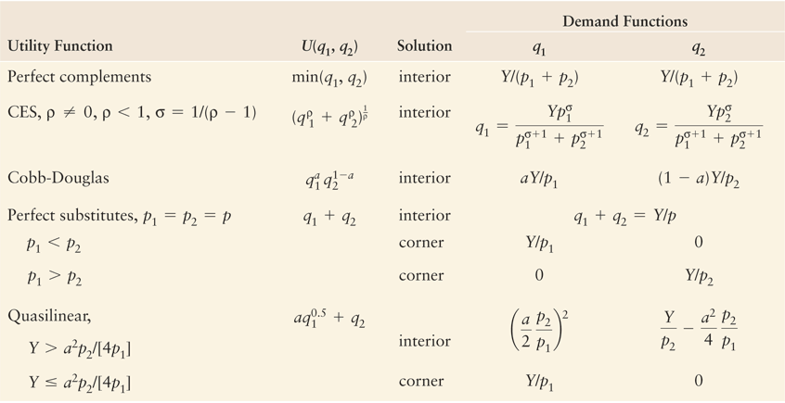
Demand Functions

Slide 3
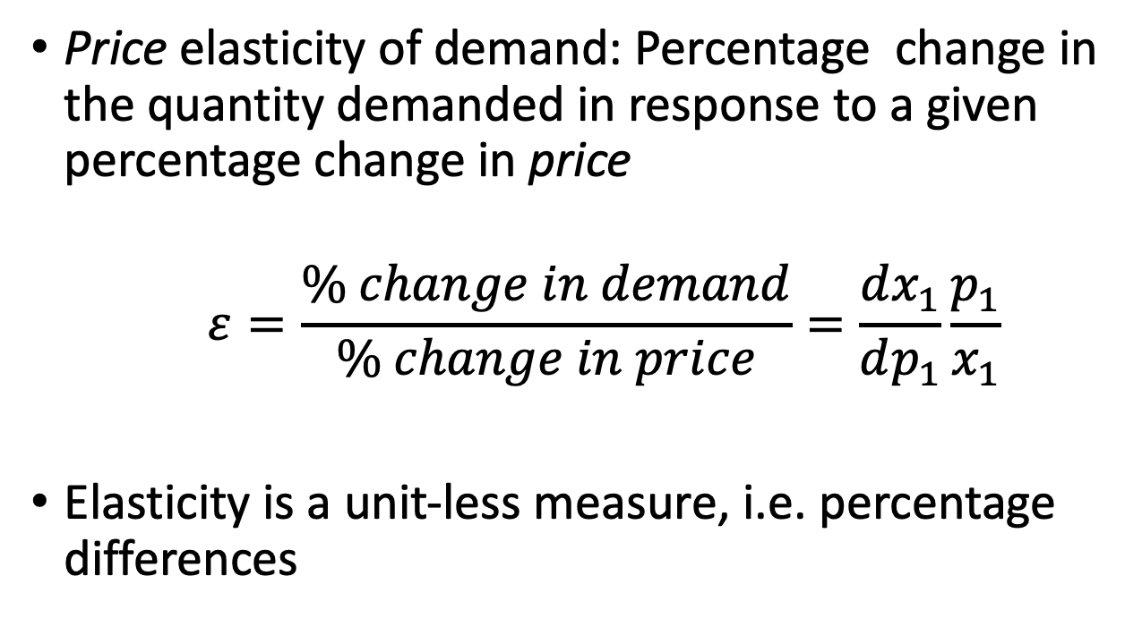
Price Elasticity
Price elasticity of demand: Percentage change in the quantity demanded in response to a given percentage change in price
$$ε=\frac{\% change in demand}{\% change in price}=\frac{dx_{1}}{dp_{1}}\frac{p_{1}}{x_{1}}$$
Elasticity is a unit-less measure, i.e. percentage differences

Slide 4
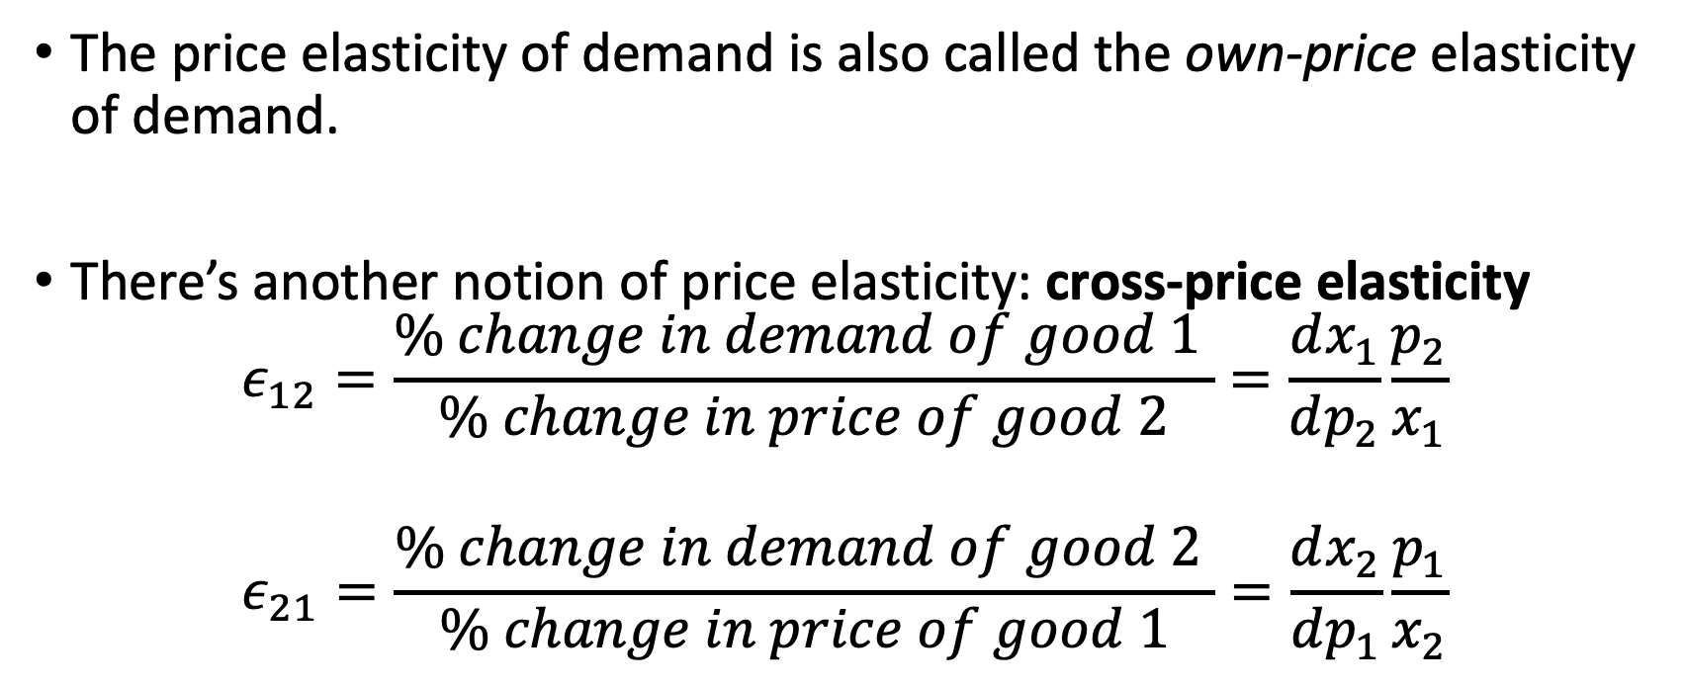
Price Elasticity
The price elasticity of demand is also called the own-price elasticity of demand.
There’s another notion of price elasticity: cross-price elasticity
$$ε_{12}=\frac{\% change in demand of good 1 }{\% change in price of good 2}=\frac{dx_{1}}{dp_{2}}\frac{p_{2}}{x_{1}}$$
$$ε_{21}=\frac{\% change in demand of good 2 }{\% change in price of good 1}=\frac{dx_{2}}{dp_{1}}\frac{p_{1}}{x_{2}}$$

Slide 5
Cross-Price Elasticity
The price elasticity of demand is also called the own-price elasticity of demand.
There’s another notion of price elasticity: cross-price elasticity
$$ε_{12}=\frac{\% change in demand of good 1 }{\% change in price of good 2}=\frac{dx_{1}}{dp_{2}}\frac{p_{2}}{x_{1}}$$
$$ε_{21}=\frac{\% change in demand of good 2 }{\% change in price of good 1}=\frac{dx_{2}}{dp_{1}}\frac{p_{1}}{x_{2}}$$

Slide 6
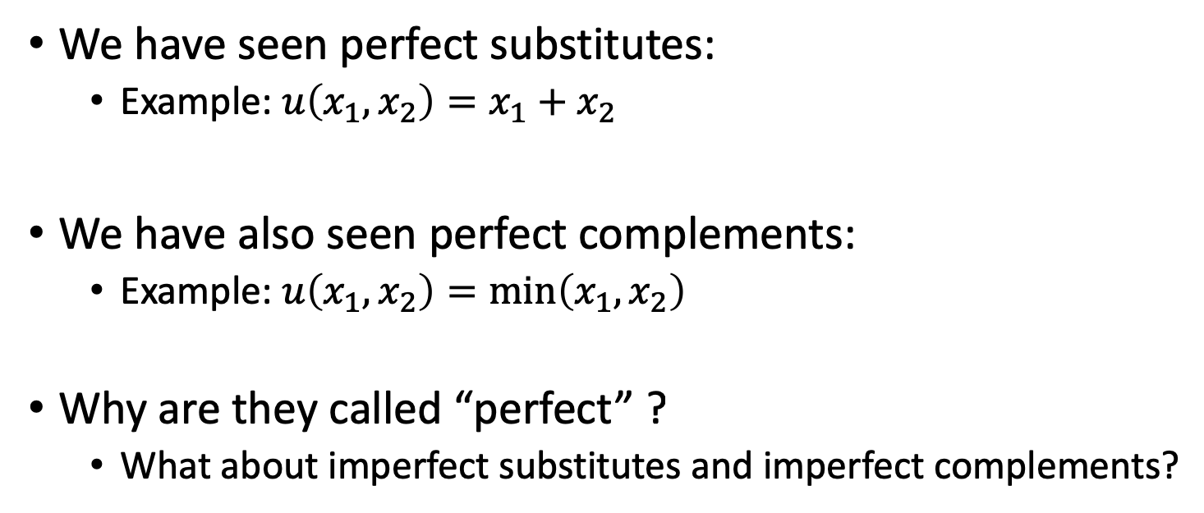
Cross-Price Elasticity
We have seen perfect substitutes:
Example: $u\left(x_{1}, x_{2}\right)=x_{1}+x_{2}$
We have also seen perfect complements:
Example: $u\left(x_{1},x_{2}\right)=\min\left(x_{1},x_{2}\right)$
Why are they called “perfect” ?
What about imperfect substitutes and imperfect complements?

Slide 7
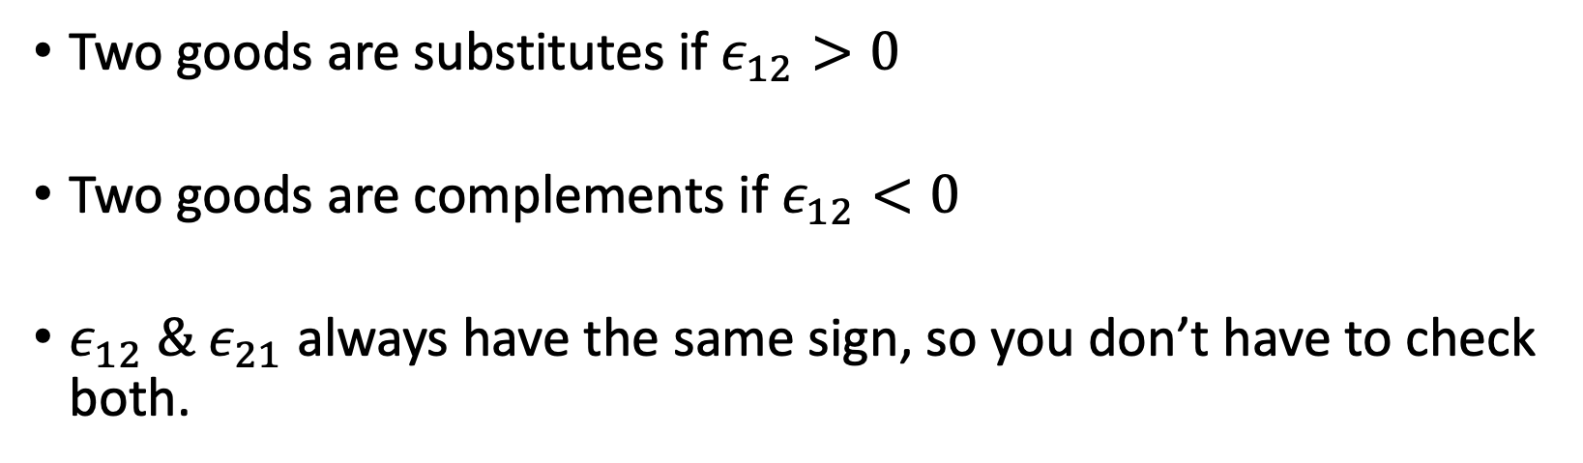
Cross-Price Elasticity
Two goods are substitutes if $ε_{12}>0$
Two goods are complements if $ε_{12}<0$
$ε_{12} \& ε_{21}$ always have the same sign, so you don’t have to check both.

Slide 8
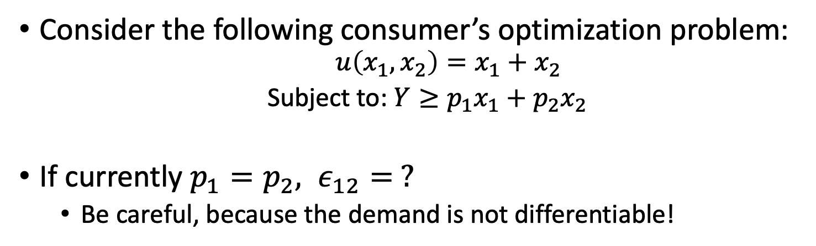
Cross-Price Elasticity Perfect Substitutes
Consider the following consumer’s optimization problem:
$$u\left(x_{1},x_{2}\right)=x_{1}+x_{2}$$
Subject to: $Y≥p_{1}x_{1}+p_{2}x_{2}$
If currently $p_{1}=p_{2}, ε_{12}= ?$
Be careful, because the demand is not differentiable!

Slide 9
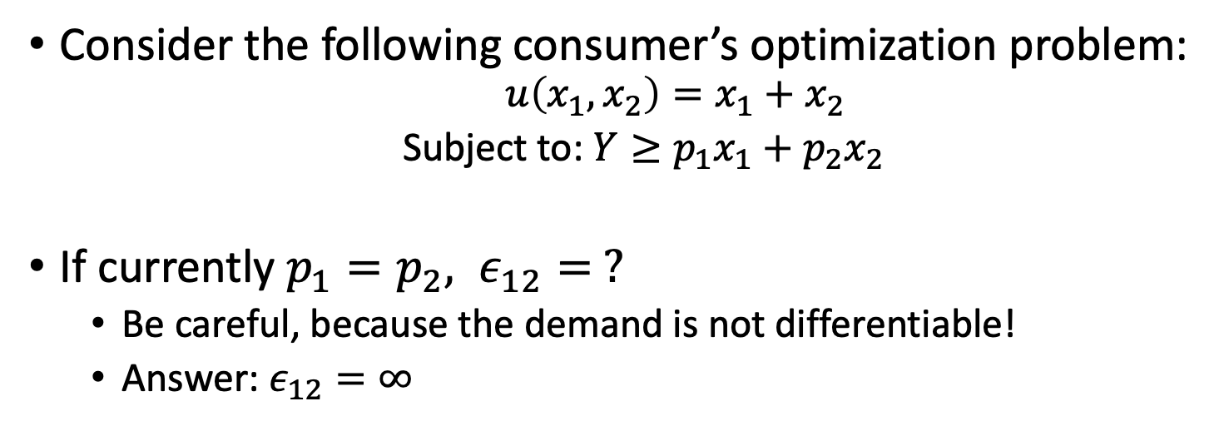
Cross-Price Elasticity Perfect Substitutes
Consider the following consumer’s optimization problem:
$$u\left(x_{1},x_{2}\right)=x_{1}+x_{2}$$
Subject to: $Y≥p_{1}x_{1}+p_{2}x_{2}$
If currently $p_{1}=p_{2}, ε_{12}= ?$
Be careful, because the demand is not differentiable!
Answer: $ε_{12}=∞$

Slide 10
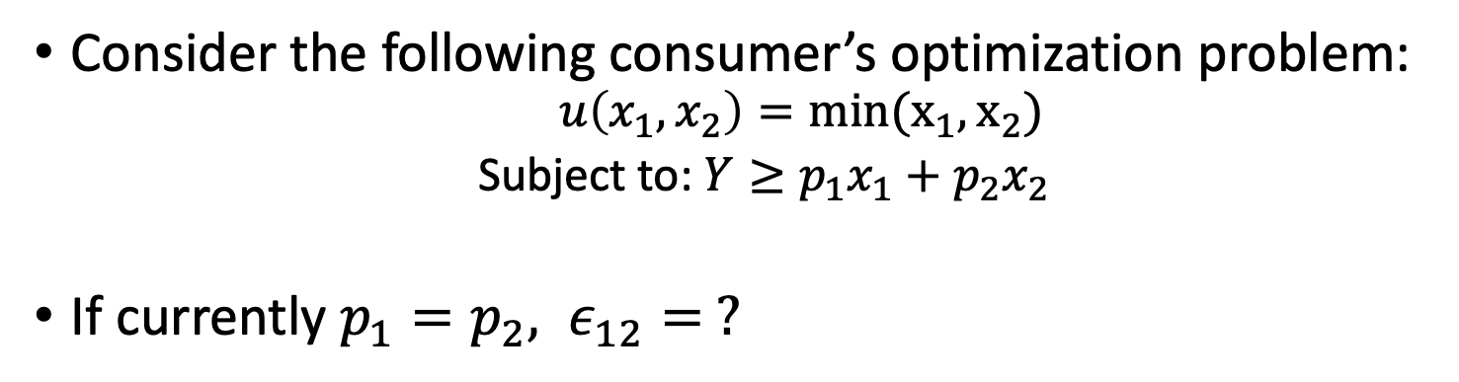
Cross-Price Elasticity Perfect Complements
Consider the following consumer’s optimization problem:
$$u\left(x_{1},x_{2}\right)=min(x_{1},x_{2})$$
Subject to: $Y≥p_{1}x_{1}+p_{2}x_{2}$
If currently $p_{1}=p_{2}, ε_{12}= ?$

Slide 11
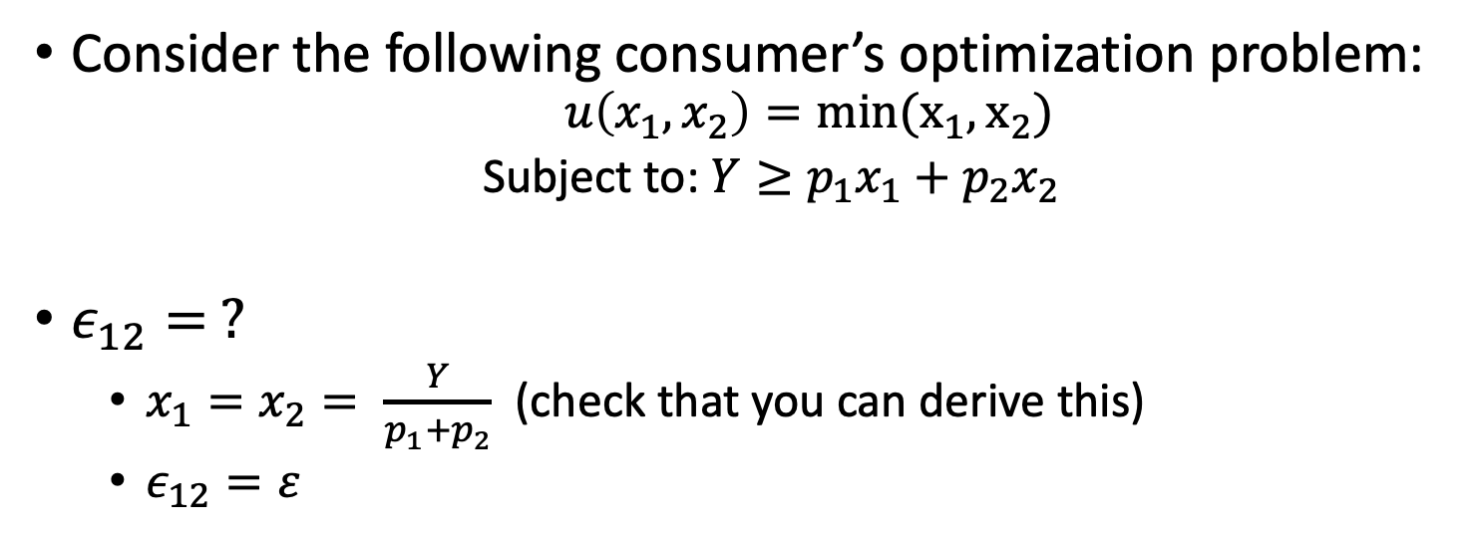
Cross-Price Elasticity Perfect Complements
Consider the following consumer’s optimization problem:
$$u\left(x_{1},x_{2}\right)=min(x_{1},x_{2})$$
Subject to: $Y≥p_{1}x_{1}+p_{2}x_{2}$
$ε_{12}= ?$
$x_{1}=x_{2}= \frac{Y}{p_{1}+p_{2}}$ (check that you can derive this)
$ε_{12}=ε$

Slide 12
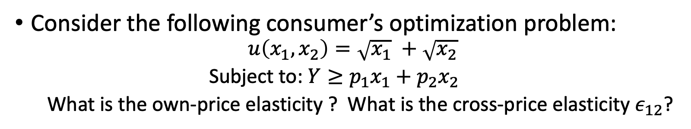
Cross-Price Elasticity More Example
Consider the following consumer’s optimization problem:
$$u\left(x_{1},x_{2}\right)=\sqrt{x_{1}} +\sqrt{x_{2}}$$
Subject to: $Y≥p_{1}x_{1}+p_{2}x_{2}$
What is the own-price elasticity ? What is the cross-price elasticity $ε_{12}$?

